Slide 1

TD 智慧選材系統
技術開發二處
技術開發三課
2021/11/29

Slide 2
智慧材料挑選 sys. :
TR2光學計算器(選出適合的LC) → RA explorer(PI/Seal)搭配性
VOC
材料選材資料庫
(TR2)
搭配 supplier roadmap 確認是否能開發材料
光學規格
LC 選材
(TR2光學)
TR2 光學計算器
決定LC
候選
TR2
離子搭配性
( jar test)
TR2
配向力
搭配性
TR2
接著力
搭配性
TR2 LTS
(Bulk LTS)
( jar test LTS)
(SLV loss LTS)
Benchmark
業界水準
LC datasheet
PI datasheet
Seal datasheet
決定 PI候選
決定Seal候選
RA explorer
TR3/產品OPT/RA/IS
資料庫
決定
材料型號
確認過往的 OPT/IS/RA issue 風險

Slide 3
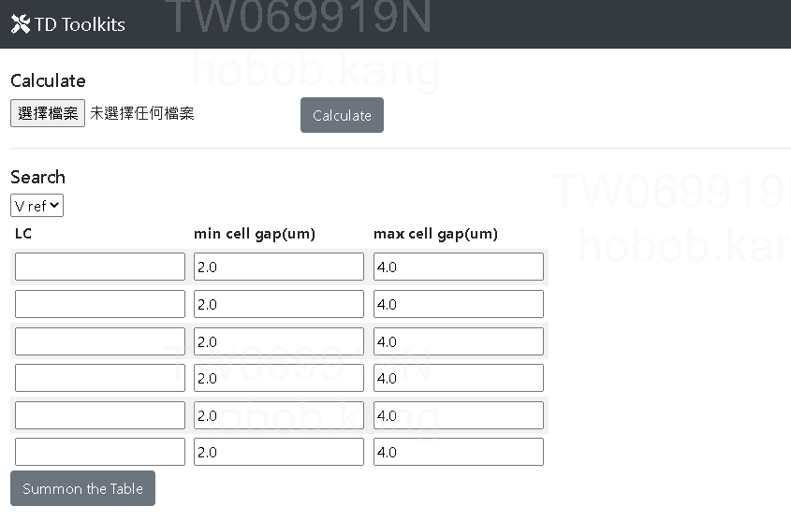
TR2 光學計算器:
0
上傳 row data, 建立資料庫
(資料庫數據為持續累加)
1
選定以產品當 ref. or LC本身操作電壓(材料本質)
2
挑選需要的LC 與 cell gap 範圍
3

Slide 4
TR2 光學計算器:
 | LC | Vop(V) | V% | Δnd(nm) | Gap(um) | LC% | u' | v' | Δ(u', v') | ΔEab* | CR | ΔCR(%) | T% | Tr(ms) | Tf(ms) | RT(ms) | G2G(ms) | platform_ref | Tr(ms)_ref | Tf(ms)_ref | RT(ms)_ref | G2G(ms)_ref | CR_ref
0 | LCT-15-1098 | 3.9 | Vref | 252 | 2.6 | 47.5 | 0.190 | 0.416 | 0.003 | 9.068 | 1611 | 14 | 74.31 | 12.3 | 7.7 | 19.8 | 24.2 | 6512 | 15.1 | 6.3 | 12.7 | 15.6 | 1411
1 | LCT-15-1098 | 3.9 | Vref | 262 | 2.7 | 50.2 | 0.190 | 0.420 | 0.003 | 7.670 | 1567 | 11 | 75.04 | 12.9 | 8.3 | 21.0 | 25.7 | 6512 | 15.1 | 6.3 | 12.7 | 15.6 | 1411
2 | LCT-15-1098 | 3.9 | Vref | 272 | 2.8 | 52.8 | 0.190 | 0.423 | 0.003 | 6.609 | 1525 | 8 | 75.76 | 13.4 | 8.9 | 22.3 | 27.2 | 6512 | 15.1 | 6.3 | 12.7 | 15.6 | 1411
3 | LCT-15-1098 | 3.9 | Vref | 281 | 2.9 | 55.4 | 0.191 | 0.426 | 0.003 | 5.793 | 1487 | 5 | 76.48 | 14.0 | 9.5 | 23.5 | 28.8 | 6512 | 15.1 | 6.3 | 12.7 | 15.6 | 1411
4 | LCT-15-1098 | 3.9 | Vref | 291 | 3.0 | 58.0 | 0.191 | 0.430 | 0.003 | 5.176 | 1451 | 3 | 77.21 | 14.6 | 10.1 | 24.8 | 30.3 | 6512 | 15.1 | 6.3 | 12.7 | 15.6 | 1411
5 | LCT-15-1098 | 3.9 | Vref | 301 | 3.1 | 60.6 | 0.192 | 0.433 | 0.003 | 4.735 | 1417 | 0 | 77.93 | 15.2 | 10.7 | 26.0 | 31.8 | 6512 | 15.1 | 6.3 | 12.7 | 15.6 | 1411
6 | LCT-15-1098 | 3.9 | Vref | 310 | 3.2 | 63.3 | 0.192 | 0.436 | 0.003 | 4.463 | 1386 | -2 | 78.65 | 15.7 | 11.3 | 27.2 | 33.3 | 6512 | 15.1 | 6.3 | 12.7 | 15.6 | 1411
7 | LCT-15-1098 | 3.9 | Vref | 320 | 3.3 | 65.9 | 0.193 | 0.439 | 0.003 | 4.360 | 1356 | -4 | 79.38 | 16.3 | 11.9 | 28.5 | 34.8 | 6512 | 15.1 | 6.3 | 12.7 | 15.6 | 1411
8 | LCT-15-1098 | 3.9 | Vref | 330 | 3.4 | 68.5 | 0.194 | 0.443 | 0.003 | 4.428 | 1328 | -6 | 80.10 | 16.9 | 12.5 | 29.7 | 36.4 | 6512 | 15.1 | 6.3 | 12.7 | 15.6 | 1411
9 | LCT-15-1098 | 3.9 | Vref | 340 | 3.5 | 71.1 | 0.195 | 0.446 | 0.003 | 4.666 | 1302 | -8 | 80.82 | 17.5 | 13.1 | 31.0 | 37.9 | 6512 | 15.1 | 6.3 | 12.7 | 15.6 | 1411
10 | LCT-15-1098 | 3.9 | Vref | 349 | 3.6 | 73.8 | 0.196 | 0.449 | 0.003 | 5.076 | 1277 | -9 | 81.55 | 18.0 | 13.7 | 32.2 | 39.4 | 6512 | 15.1 | 6.3 | 12.7 | 15.6 | 1411
11 | ILD-843001 | 3.9 | Vref | 270 | 2.6 | 53.7 | 0.192 | 0.438 | 0.004 | 3.399 | 1496 | 6 | 74.37 | 11.9 | 7.4 | 19.5 | 23.9 | 6512 | 15.1 | 6.3 | 12.7 | 15.6 | 1411
12 | ILD-843001 | 3.9 | Vref | 281 | 2.7 | 55.2 | 0.192 | 0.436 | 0.002 | 1.938 | 1451 | 3 | 74.94 | 12.5 | 8.0 | 20.8 | 25.4 | 6512 | 15.1 | 6.3 | 12.7 | 15.6 | 1411
13 | ILD-843001 | 3.9 | Vref | 291 | 2.8 | 56.8 | 0.192 | 0.435 | 0.001 | 0.890 | 1410 | 0 | 75.51 | 13.2 | 8.7 | 22.0 | 27.0 | 6512 | 15.1 | 6.3 | 12.7 | 15.6 | 1411
14 | ILD-843001 | 3.9 | Vref | 302 | 2.9 | 58.3 | 0.192 | 0.435 | 0.000 | 1.526 | 1372 | -3 | 76.08 | 13.9 | 9.3 | 23.3 | 28.5 | 6512 | 15.1 | 6.3 | 12.7 | 15.6 | 1411
15 | ILD-843001 | 3.9 | Vref | 312 | 3.0 | 59.8 | 0.192 | 0.437 | 0.002 | 2.844 | 1336 | -5 | 76.65 | 14.5 | 10.0 | 24.5 | 30.0 | 6512 | 15.1 | 6.3 | 12.7 | 15.6 | 1411
16 | ILD-843001 | 3.9 | Vref | 322 | 3.1 | 61.3 | 0.193 | 0.440 | 0.003 | 4.227 | 1302 | -8 | 77.22 | 15.2 | 10.7 | 25.8 | 31.6 | 6512 | 15.1 | 6.3 | 12.7 | 15.6 | 1411
17 | ILD-843001 | 3.9 | Vref | 333 | 3.2 | 62.8 | 0.193 | 0.444 | 0.004 | 5.615 | 1271 | -10 | 77.79 | 15.9 | 11.3 | 27.1 | 33.1 | 6512 | 15.1 | 6.3 | 12.7 | 15.6 | 1411
18 | ILD-843001 | 3.9 | Vref | 343 | 3.3 | 64.4 | 0.194 | 0.449 | 0.005 | 7.001 | 1242 | -12 | 78.36 | 16.5 | 12.0 | 28.3 | 34.6 | 6512 | 15.1 | 6.3 | 12.7 | 15.6 | 1411
19 | ILD-843001 | 3.9 | Vref | 354 | 3.4 | 65.9 | 0.195 | 0.455 | 0.006 | 8.394 | 1214 | -14 | 78.93 | 17.2 | 12.7 | 29.6 | 36.2 | 6512 | 15.1 | 6.3 | 12.7 | 15.6 | 1411
20 | ILD-843001 | 3.9 | Vref | 364 | 3.5 | 67.4 | 0.196 | 0.463 | 0.007 | 9.805 | 1188 | -16 | 79.50 | 17.9 | 13.3 | 30.8 | 37.7 | 6512 | 15.1 | 6.3 | 12.7 | 15.6 | 1411
21 | ILD-843001 | 3.9 | Vref | 374 | 3.6 | 68.9 | 0.197 | 0.471 | 0.008 | 11.253 | 1163 | -18 | 80.07 | 18.5 | 14.0 | 32.1 | 39.3 | 6512 | 15.1 | 6.3 | 12.7 | 15.6 | 1411
光學計算器直接模擬選定的LC在不同 cell gap下，於產品上的光學水準

Slide 5
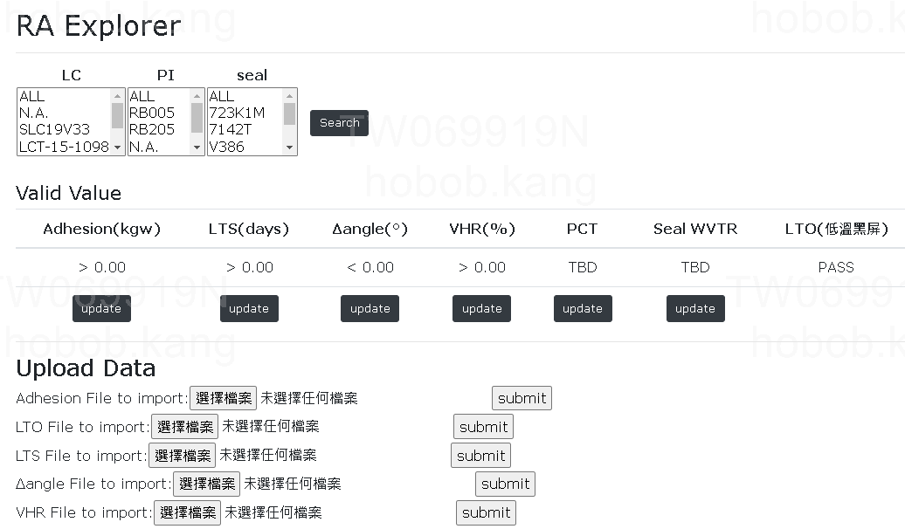
1
3
挑選需要的材料組態
設定Criteria
2
0
上傳 row data, 建立資料庫
(資料庫數據為持續累加)

Slide 6
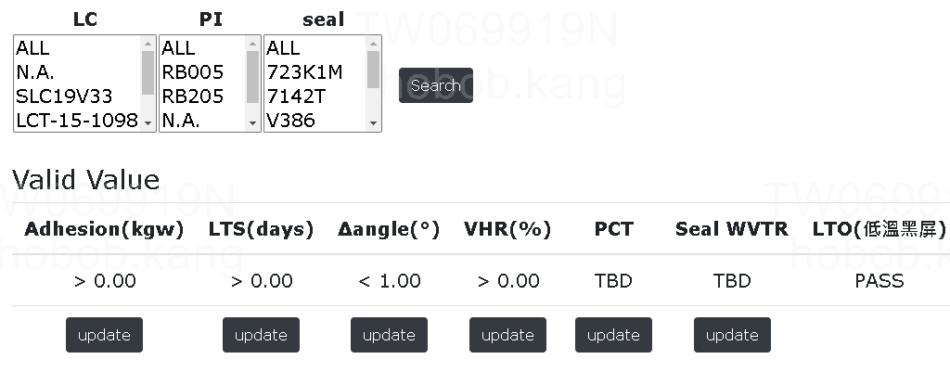
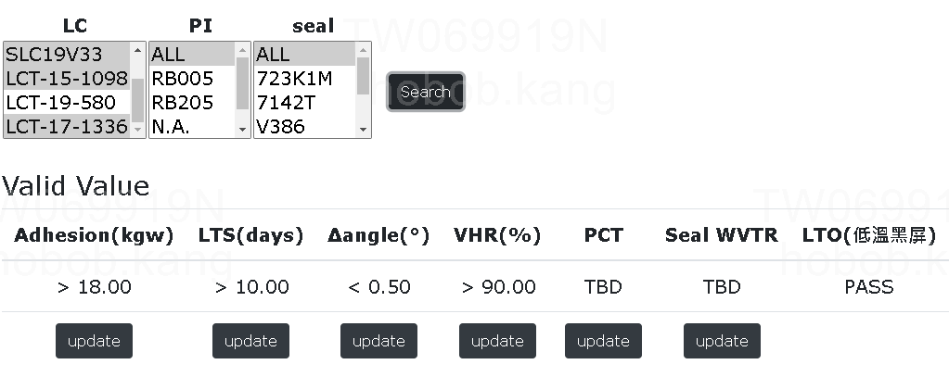
得到 103 筆數據
加入 criteria
得到 29 筆數據
若 criteria 設定的夠精準，
則可得到最佳 1～2組組態

Slide 7
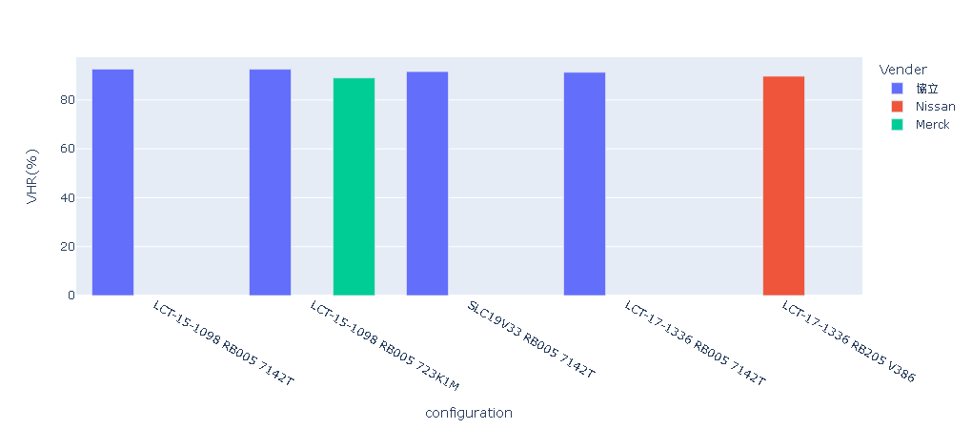
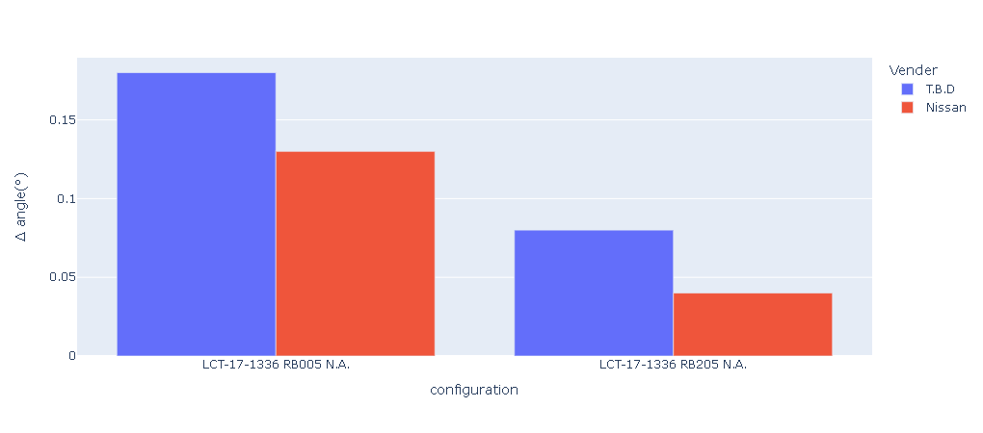
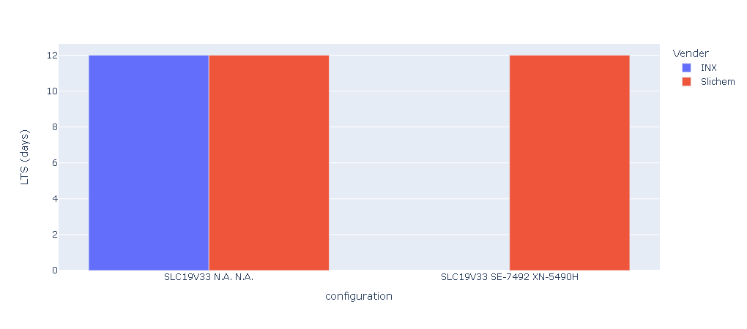
各RA特性圖表顯示供參考: (僅會秀出符合 criteria 的組態)

Slide 8
材評表 (僅會秀出符合 criteria 的組態): in future
For example ( 假設 PI/seal 不變):
分數 | Merck LCT-OO-OOO | 誠志永華 SLCAAAAAA | 江蘇和成 ILDBBBBBB | BAYI QCCCCCC
LC% | 9 | 7 | 7 | 5
CR | 5 | 5 | 7 | 7
RT | 9 | 5 | 5 | 3
G2G | 9 | 5 | 5 | 3
VHR(%) | 9 | 7 | 7 | 7
Delta angle | 9 | 9 | 7 | 7
LTS | 1 | 5 | 5 | 7
TBD | 1 | 3 | 7 | 1
Total | 52 | 46 | 50 | 40

Slide 9
TR3/產品RA資料庫
LC | PI | Seal | Phase | 廠區 | 產品 | TFT元件 | APR | L/R Border (mm) | 挖溝設計 | Pol(上偏) | BLU 等效亮度 (nits) | HHO | HHS | HHO | HHS | HTO | LTO & LT start | LTO & LT start | LTS | LTS | PCT (hr) | HTS | 黃斑 (<0.003)
VNJ6005L17C | SE-6814 | K1M | TR3 | T2 | 7058 | A-si | 塊狀 | 1.8 | NA | GRT1794XH1UHC3-6 | 10000 | 85C/85%,1000hr | 85C/85%,750hr | 65C/95%,1000hr | 65C/95%,1000hr | 70C,1000hr | -20C,1000hr | -30C,240hr | -40C,500hr | -50C,500hr | 30hr | NA | -40Kpa
VNJ6005L17C | SE-6814 | K1M | 新產品 | T2 | 7058 | A-si | 塊狀 | 1.8 | NA | GRT1794XH1UHC3-6 | 10000 |  |  | 60C/90%,1000hr | 60C/90%,1000hr | 80C,1000hr |  |  | -25C,240hr |  |  | 70C,240hr
LCT-19-580 | RB005 | 7142T | TR3 | T6 | 6601 | LTPS | 條狀 | 0.7 | NA | GRT1794XH1UHC3 | 14000 | 85C/85%,750hr bubble | 85C/85%,500hr bubble | 65C/95%,有黑斑 | 65C/95%,有黑斑 | 70C,1000hr | -20C,1000hr |  | -40C,500hr | -50C,240hr | 18hr | 120C/500hr | -50Kpa
LCT-19-580 | RB005 | K1M | TR3.5 | T6 | 6601 | LTPS | 條狀 | 0.7 | NA | GRT1794XH1UHC3 | 14000 | 85C/85%,576hr bubble | 85C/85%,1000hr bubble | 65C/95%,500hr | 65C/95%,有黑斑 | 70C,240hr | -20C,1000hr |  | -40C,500hr | -50C,500hr | 12hr | 120C/1000hr

Slide 10
TR3/產品RA資料庫
T2 SLC19V33殘影規格合規與NG客戶
MP
非對稱補值 | Huawei | OPPO | VIVO | 華勤 | Lenovo
+175mV | 1h 切 127灰→3min 不可見 | 5min 切 32/ 64灰 不可見 1h 切 127灰-->5min 不可見 | 1h 切127灰 不可見 (棋盤格 : 7*15) (8011 測試Pass) | 30min 切 41/ 64/ 128灰-->3min 不可見 1h 切 41/ 64/ 128灰-->3min 不可見 (32灰取代41灰) | 1h 切 60灰-->5min 不可見 2h 切 128灰-->5min 不可見 (TR3 M4 std片已用罄, TR3.5進行)
Tablet |  |  |  | PC
非對稱補值 | Huawei | Lenovo | Google | Lenovo | Huawei
+175mV | 1hr 切 128灰-->3min 不可見 | 30min 切 128灰-->3min 不可見 | 5min 切 127灰 --> 5s 不可見 4h , 切 127灰--> 5min 不可見 48h , 切 127灰--> 5min 不可見 | 每 5min 到 30min 0~63灰-->30s ≦L1 30min / 2h / 4h 0~63灰-->30s ≦L1 10h 40~63灰-->30s ≦L1 | 1hr 切 127灰→不可見 (可過8h內規的 code,無法1h立判L0, But Ref. 1098也沒辦法. 目前正另外尋找一組可短時間L0的code)

Slide 11
TR3/產品OPT資料庫
廠區 |  |  |  | T2 | T2
TFT 元件 |  |  |  | a-si | a-si
Item |  | Symbol | Unit | 6512 | 6512
LC |  |  |  | 1098 | ILD843001
W/D Voltage |  |  | V/V | 5.55/0.1 | 5.55/0.1
Cell Gap |  |  | μm | 3.09 | 3.10
Dark State |  |  | cd/m2 | 0.275 | 0.310
Luminance |  | L | cd/m2 | 434 | 445
BLU Brightness |  |  | cd/m2 | 9306 | 9305
Contrast Ratio |  | CR |  | 1587 | 1442
Panel T% (w/ APCF) |  |  |  | 4.67% | 4.79%
Apeture Ratio |  |  |  | 51.90% | 52.02%
Panel T%_Corrected (w/ APCF) |  |  |  | 4.67% | 4.80%
Color Chromaticity | White | Wx | CIE 1931 | 0.305 | 0.314
 |  | Wy |  | 0.317 | 0.328
 | Red | Rx |  | 0.640 | 0.641
 |  | Ry |  | 0.338 | 0.339
 | Green | Gx |  | 0.321 | 0.323
 |  | Gy |  | 0.598 | 0.600
 | Blue | Bx |  | 0.153 | 0.153
 |  | By |  | 0.048 | 0.050
Response Time (on/off) |  | RT | ms | 25.5 | 25.4
Gray to Gray |  | GTG | ms | 31.5 | 32.3
Color Gamut |  | NTSC | CIE 1931 | 69.2% | 69.3%
BP thk. |  |  | A | 4000 | 4000
Slit angle |  |  | 度 | 7 | 7

Slide 12
VOC
 |  |  |  |  |  | 提供單位 | 備註
廠區 |  |  |  | T2 | T2 | PM | 開案廠區
TFT 元件 |  |  |  | a-si | a-si | PM
Item |  | Symbol | Unit | 6512 | 6512 | PM | 產品名
LC |  |  |  | 1098 | ILD843001 | 光學/TD | 如果有wish優先的LC
W/D Voltage |  |  | V/V | 5.55/0.1 | 5.55/0.1 | EE/光學 | 確認IC電壓與白電壓
Luminance |  | L | cd/m2 | 434 | 445 | PM | 整機亮度
BLU Brightness |  |  | cd/m2 | 9306 | 9305 | PD
Contrast Ratio |  | CR |  | 1587 | 1442 | PM | 提供規格
Panel T% (w/ APCF) |  |  |  | 4.67% | 4.79% | 光學
Panel T%_Corrected (w/ APCF) |  |  |  | 4.67% | 4.80% | 光學
Color Chromaticity | White | Wx | CIE 1931 | 0.305 | 0.314 | 光學
 |  | Wy |  | 0.317 | 0.328 | 光學
 | Red | Rx |  | 0.64 | 0.641 | 光學
 |  | Ry |  | 0.338 | 0.339 | 光學
 | Green | Gx |  | 0.321 | 0.323 | 光學
 |  | Gy |  | 0.598 | 0.6 | 光學
 | Blue | Bx |  | 0.153 | 0.153 | 光學
 |  | By |  | 0.048 | 0.05 | 光學
常溫 Response Time (on/off) |  | RT | ms | 25.5 | 25.4 | PM | 提供規格
常溫 Gray to Gray |  | GTG | ms | 31.5 | 32.3 | PM | 提供規格
低溫 Response Time (on/off) |  | RT | ms | 200 | 200 | PM | 提供規格
低溫 Gray to Gray |  | GTG | ms | xxx | xxx | PM | 提供規格
Flicker
BP thk. |  |  | A | 4000 | 4000 | 光學
Slit angle |  |  | 度 | 7 | 7 | 光學
高溫操作/儲存溫度 |  |  | 度 | 80 | 80 | PM | 提供規格
低溫操作/儲存溫度 |  |  | 度 | -30 | -40 | PM | 提供規格
*紅字的項目為必填

Slide 13

http://10.56.216.45:3000/
http://10.53.16.185:8000/ra_exploer/

